Slide 1
GENERIC LOCAL TEAM
COMMS CARD TEMPLATE
-- How to Manage Emergency Messaging During a Communications Outage or Overload –
A Template Guide for NC County and Local Amateur Radio Groups.
For Group Leaders to Customize and Distribute for Local Use.
A Project of NC AUXCOMM, Eastern Branch.
TLP RED
This document contains sensitive information and should not be shared or distributed without permission

Slide 2
[Local/COUNTY] COMU COMMUNICATIONS REFERENCE TEMPLATE (CUSTOMIZE)
*DO NOT SELF-DEPLOY*
PAMLICO COUNTY SHARES STATIONS: NNF4PC, NNA4PC (kit)
1st PRIORITY: Ensure family is taken care of and well prepared. Ensure site security and self defense. Likely no cash available nor gas. Prepare/travel accordingly.
Your Local Objectives and Tasks
Check-in and maintain a link to the net.
Check neighbors. Inform them of your resources. Report Life-safety issues to NCS. H&W is lowest priority.
Provide spot reports to Local EM>RCC-E>SEOC. Use Winlink form to NNB4NC, NNA4NC. Report updates/changes with a new report form.
Local NCS Tasks
Establish & keep alive a local net as needed. Keep a monitoring schedule. Inform often what it is. Enforce local SOP.
Maintain a backchannel contact with the county EM and RCC-E.
PACE PLAN
Callsign Usage: Use last name for tactical call until location-based tactical call sign established. Use personal amateur call or SHARES call always and ONLY at EOT.
1 – VOICE COMMUNICATIONS
Primary
Landline and cellular telephone (Consider – GETS, WPS)
Alternate
Local FM Repeater Net: i.e.
N4ONC/R 147.210+ 88.5, N4ONC/R 444.35+ 85.4
Contingent
(In order) 147.210 Simplex (TA); 146.52 Simplex; 146.55 Simplex or Alternate Local Repeater i.e.: KF4IXW/R (Grantsboro) 145.23+ 85.4
FAILSAFE
Emergency
HF USB/LSB voice, other AUXC modes (DMR, Analog), Message Runner
2 – DATA COMMUNICATIONS
Primary
Terrestrial internet connections (Cable, DSL, etc.) SMS, Email.
Alternate
Cellular broadband data (Consider band 14 options / AT&T FirstNet).
3 HRS
3 MIN
Local Leaders & Team callsign@Winlink.org
Bruce Perkins, K4ONC (AC/AUXC)..……..252-626-2730
Lor Kutchins, W3QA (DAC/COML/ ITSL)..484-356-6405
Tom Brown, N4TAB (NC AUXCOMM)..….919-971-3100
Charlie Ingle, KI4DEE (East AUXCOMM)..252-524-2056
BEASLEY, Wayne, KO4OJC…………..…252-241-1962
BARNETT, Ben, KI4NSO………………….252-670-6390
HARTMEYER, Jim, AI4WL………..249-1984, 675-3590
HURM, Mike, K4HPS………………249-1122, 675-9436
LUPTON, Joe, N4IBX…………………..….252-670-8829
MARSH, Mike, K4NLC……………..636-1257, 626-2674
OLAH, Bill, KR4LO………………....249-0287, 514-5187
NCEM/LOCAL AGENCY order of contact
Gary Mitchelson, NC3Z, Pamlico COML..252-349-0030
NC3Z.gary@gmail.com, NCS997
Chris Murray, Pamlico Co. EM…….….….252-745-4341
emc@pamlicocounty.org
NCEM Eastern Branch Office (RCC-E)....252-520-4923
NCS886, NNB4NC@Winlink.org
ESF2 Desk SEOC…....….919-733-3300, 919-825-2262
NNA4NC@Winlink.org
Greg Hauser, W3FIE, NC SWIC……....…919-618-0536 NCEMSWIC@Winlink.org
Contingent
Satellite broadband (Starlink), Winlink via Telnet,.
3 in 3 rule
For SHTF scenarios, communication windows are every 3 hours for 3 minutes on FAILSAFE channel until plan established. Monitor FAILSAFE channel at minimum for others. Ensure time is in sync when contacts made via WWV or GPS if available. Conserve power.
Emergency
SHARES/amateur HF Winlink for message retrieval and relay, then HF P2P as a last resort.
3 – Intra-team Information Sharing Platforms
Primary
SMS,
Alternate
Normal Email, Groups.io group email: pamlico@nc-auxcomm.groups.io
Contingent
Cross-platform Group Chat App (Telegram, Slack). Avoid Social Media.
Emergency
Voice phone. If this has failed, start into voice communications PACE.
NIGHT/DAY HF VOICE Freq: 3923/7232 KHz LSB SHARES SAF0, SBA0
Local Standard Operating Procedures
Activation
Telephone chain notification, group text, email, etc.
Electromagnetic Pulse (EMP)
Voice Net
147.210+ 88.5 or PACE, NCS must maintain contact with local EM and RCC-E. Resource Net: First on frequency is NCS until relieved. Establish roster of available ops and limits to availability. Set a schedule. Then begin Tactical Net: Transact business of assigned tasks/move traffic.
If EMP is suspected, 1) evaluate electronic equip is functioning; 2) eval all RF equip (vehicles/AM/FM radios). Sat & HF comms may be inoperable for 24-48 hrs. Use AM/FM radio for intel if Viper / LMR down.
Continuity
After all checkins, if net goes quiet, at 0900, 1200, 1500, 1800, 2100 local, monitor top of hour 3 minutes for NCS roll call.
COMU Group Email: PAUXC@Winlink.org, pamlico@nc-auxcomm.groups.io

Slide 3
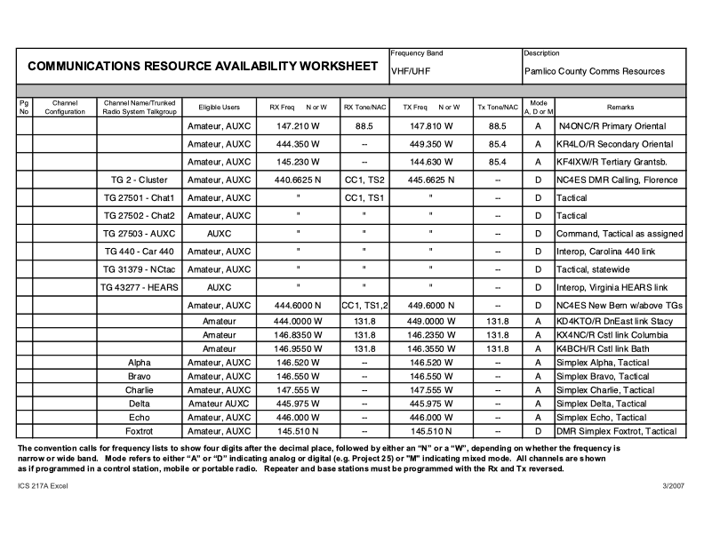

Slide 4
